Slide 1


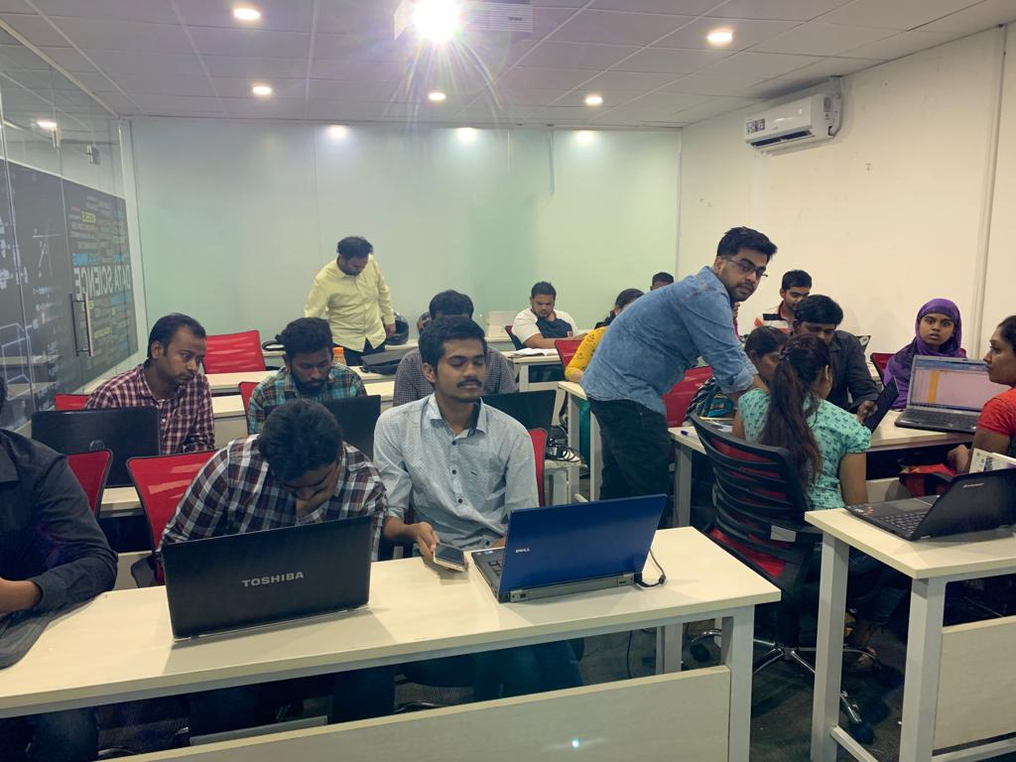

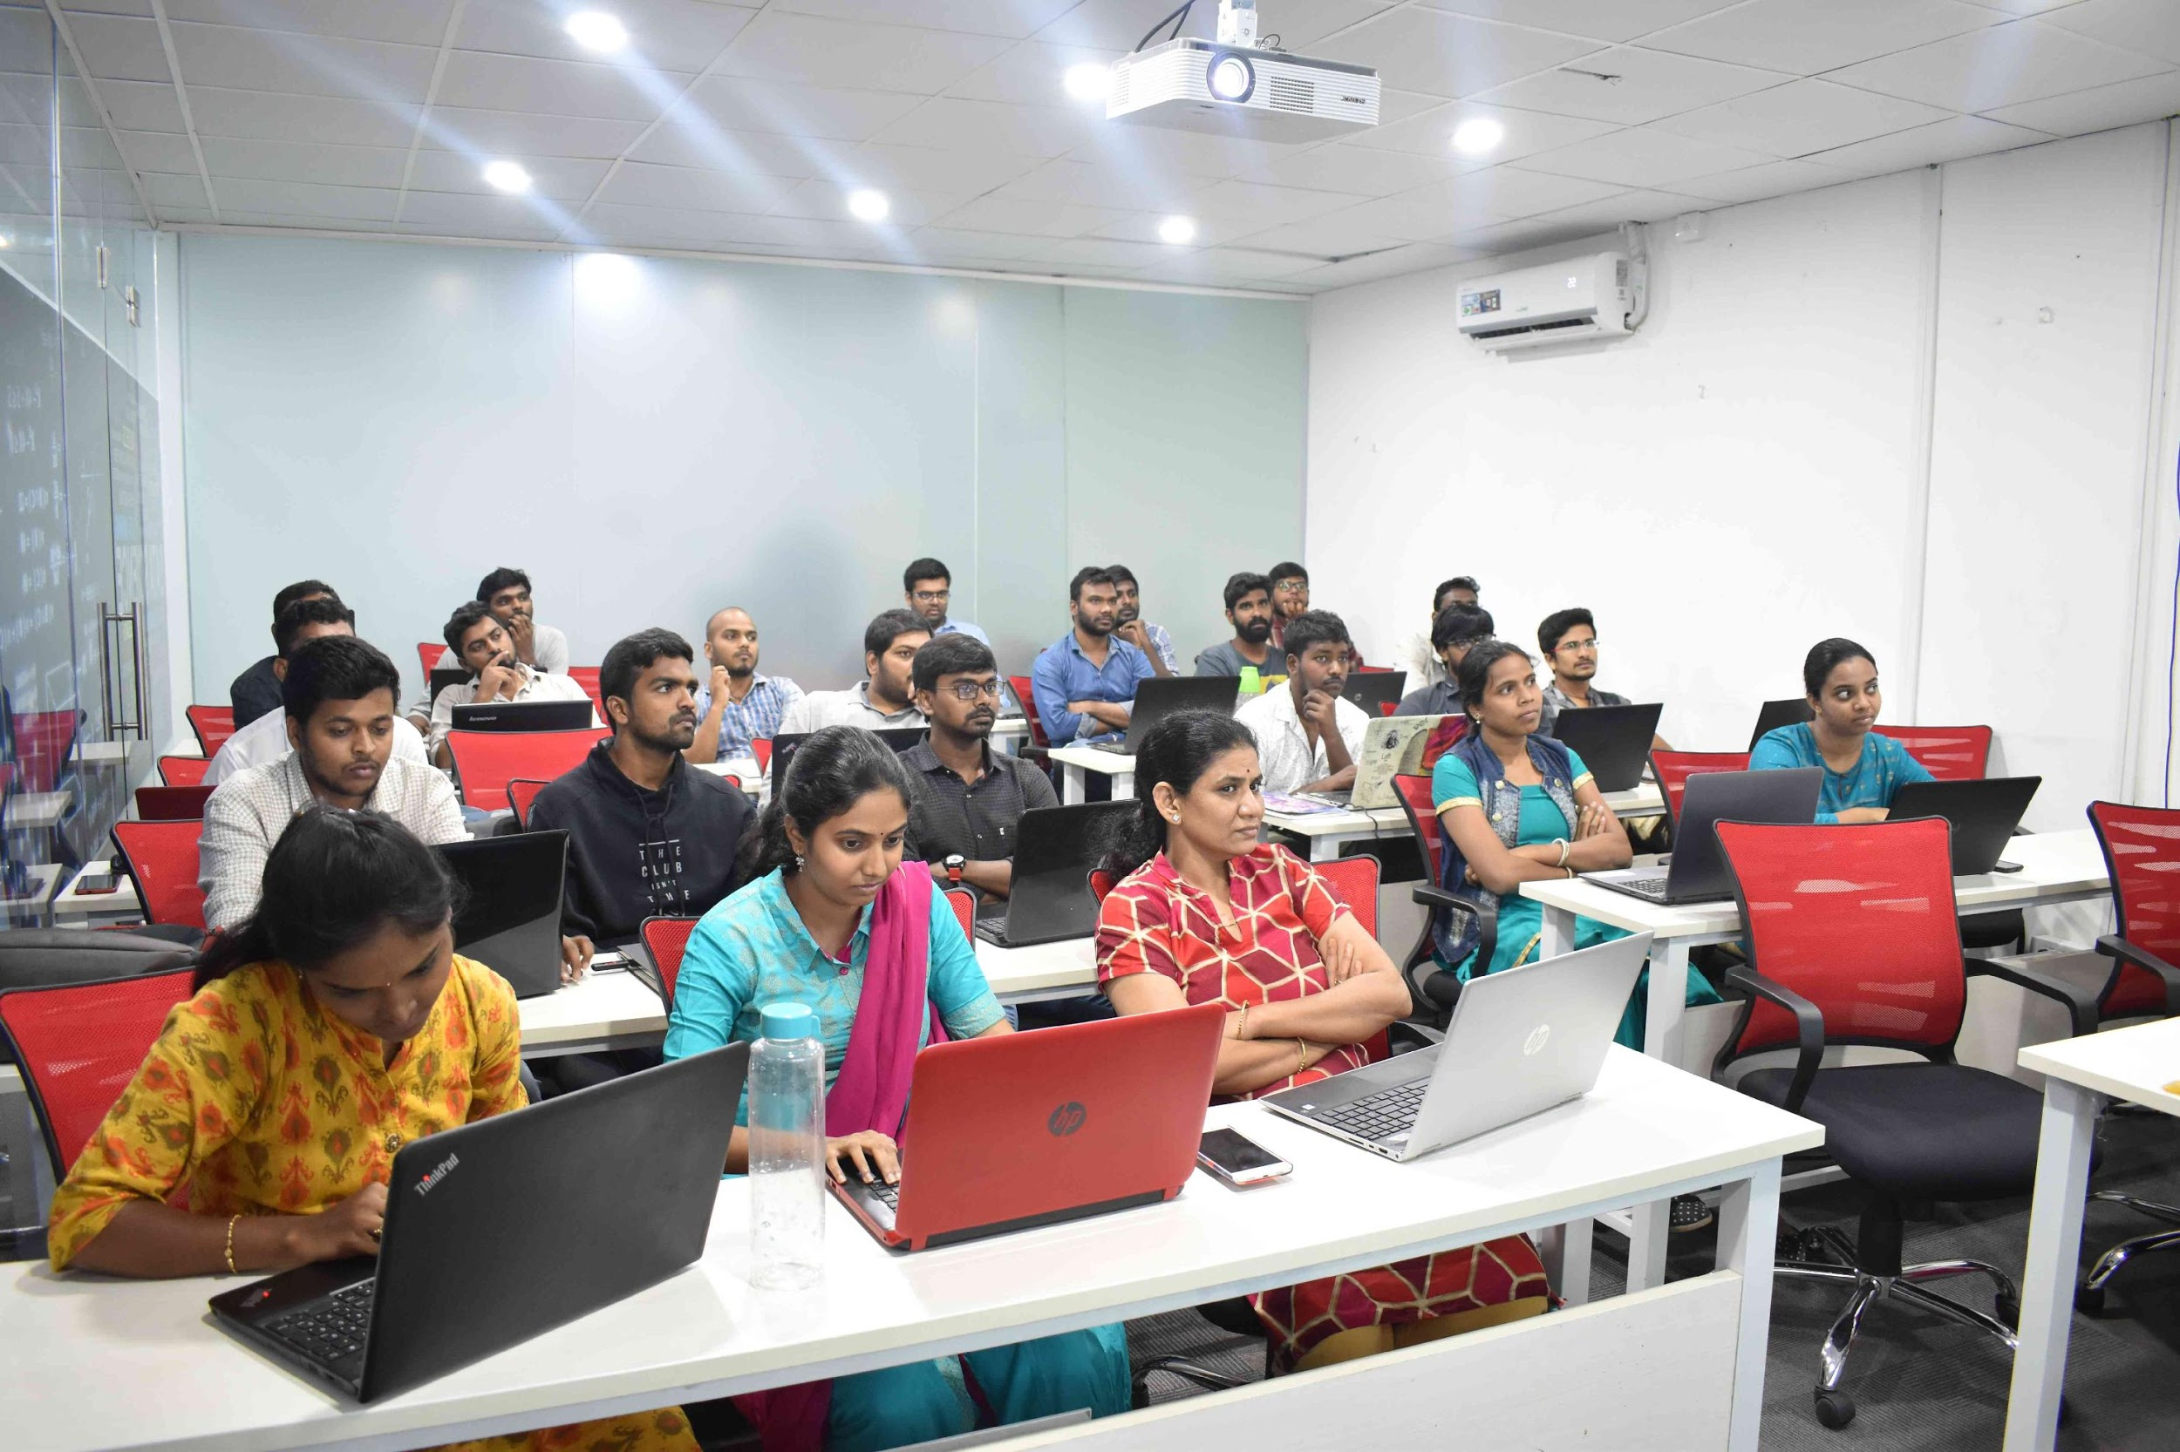



Slide 2


Web Scraping
Laptop Price Analysis
Team Members :
Sai Charan
Nirosha Chennakesavula
Notes:
Good afternoon everyone myself SaiCharan i am from nellore andhra pradesh i completed my bachelors degree in Trichy and my fellow teammate Nirosha so we are here to explain about our project that is on web scraping where we made some analysis on the laptops prices and on the features of laptops.

Slide 3

CONTENTS :
Problem statement.
Web Scraping - Details
Data Cleaning
Data Manipulation
Exploratory Data Analysis
Univariate Analysis
Bivariate Analysis
Multivariate Analysis
Notes:
So moving on to the Project These are the contents that i will be going throughout the presentation first i will be going with the problem statement , Details , Summary ,Data cleaning manipulation and the EDA part and in the EDA there are several things that we have done with the scraped data that is the analysis part like uni and bi variate.
#We can see price changes depending on some specifications like Ram,Processor,Rom.Based on Website we can analyse the price of laptop.#

Slide 4
Problem Statement :
When a person want to buy a laptop under a required Budget .
Change of prices in different e-commerce website by Brand .
The specifications that affect the price .
Notes:
So before getting into analysis if we have good understanding on our problem statement it will drive us in proper path to get the solution so these are the problem statement that we have gone through for our project if a person wants to buy a laptop under a required budget like there might be some budget range for some people and to know the change of prices in different websites based on brand like there might be some websites where the price might be lower as compared to other websites and to know how certain specifications will be affecting the price of a laptop.

Slide 5


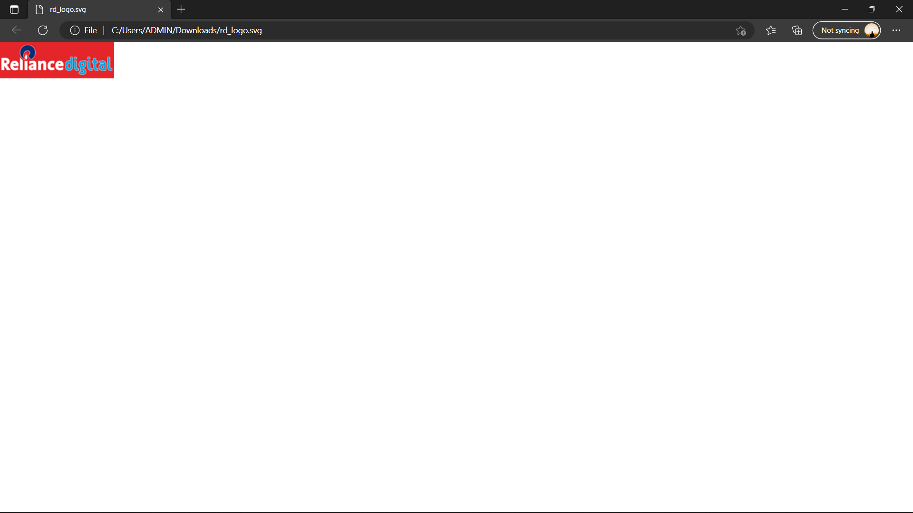



Modules Used :
Pandas
requests
BeautifulSoup (bs4)
Visualization Modules Used :
Websites :
Notes:
These are the modules that we have used like Pandas , requests and beautifulsoup as you know pandas is a python library Pandas stands for “Python Data Analysis Library”. As the full form itself says that it is an analysis library . And the requests and the beautifulsoup library these two play a key role while scraping the data Python requests module has several built-in methods to make Http requests to specific URL. A Http request is meant to either retrieve data from a specified URI or to push data to a server. And the visualization modules that we have used is matplotlib , plotly and seaborn . And at last the websites that we have chosen to scrap is flipkart , reliance digital and Dell .

Slide 6


Steps Followed :
Step 1: Collecting Contents from Web Pages
Step 2: Extracting Data from the content
Step 3: Storing the Data
Step 4: Analyzing the Data
Notes:
These are the steps we followed for the whole process so the first step is to collect the content from the website and in the next step we will be extracting the useful data and the third step is to store the data in a dataframe with the module pandas and the final step is to analyse the scraped data so as per our project we will be analyzing laptop prices to know the prices of the laptops that are changing with certain specifications and the price difference of laptops in different websites.

Slide 7
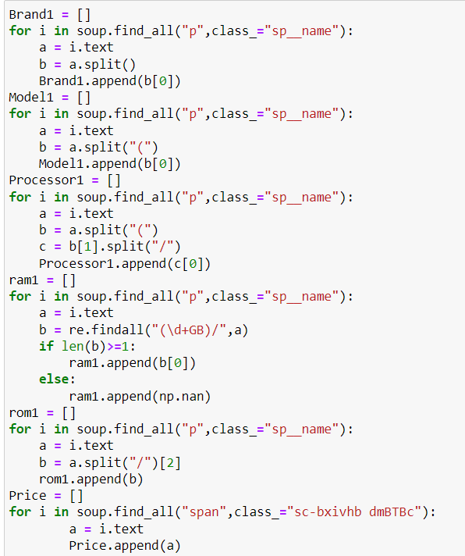
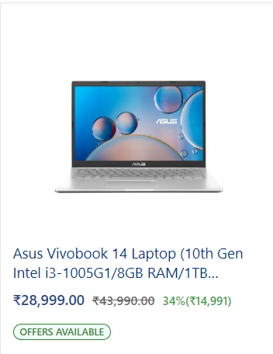
Code :
Code for scrapping Columns
Notes:
So this the code that we have followed to scrap the data that we need and as you can see these are the columns of our dataframe which consists of brand , model ,processor , ram,rom and the price so we used regular expression to get the data that might be difficult to get by split or some other operations so in regular expression we used findall function to scrap the required data that we need.

Slide 8
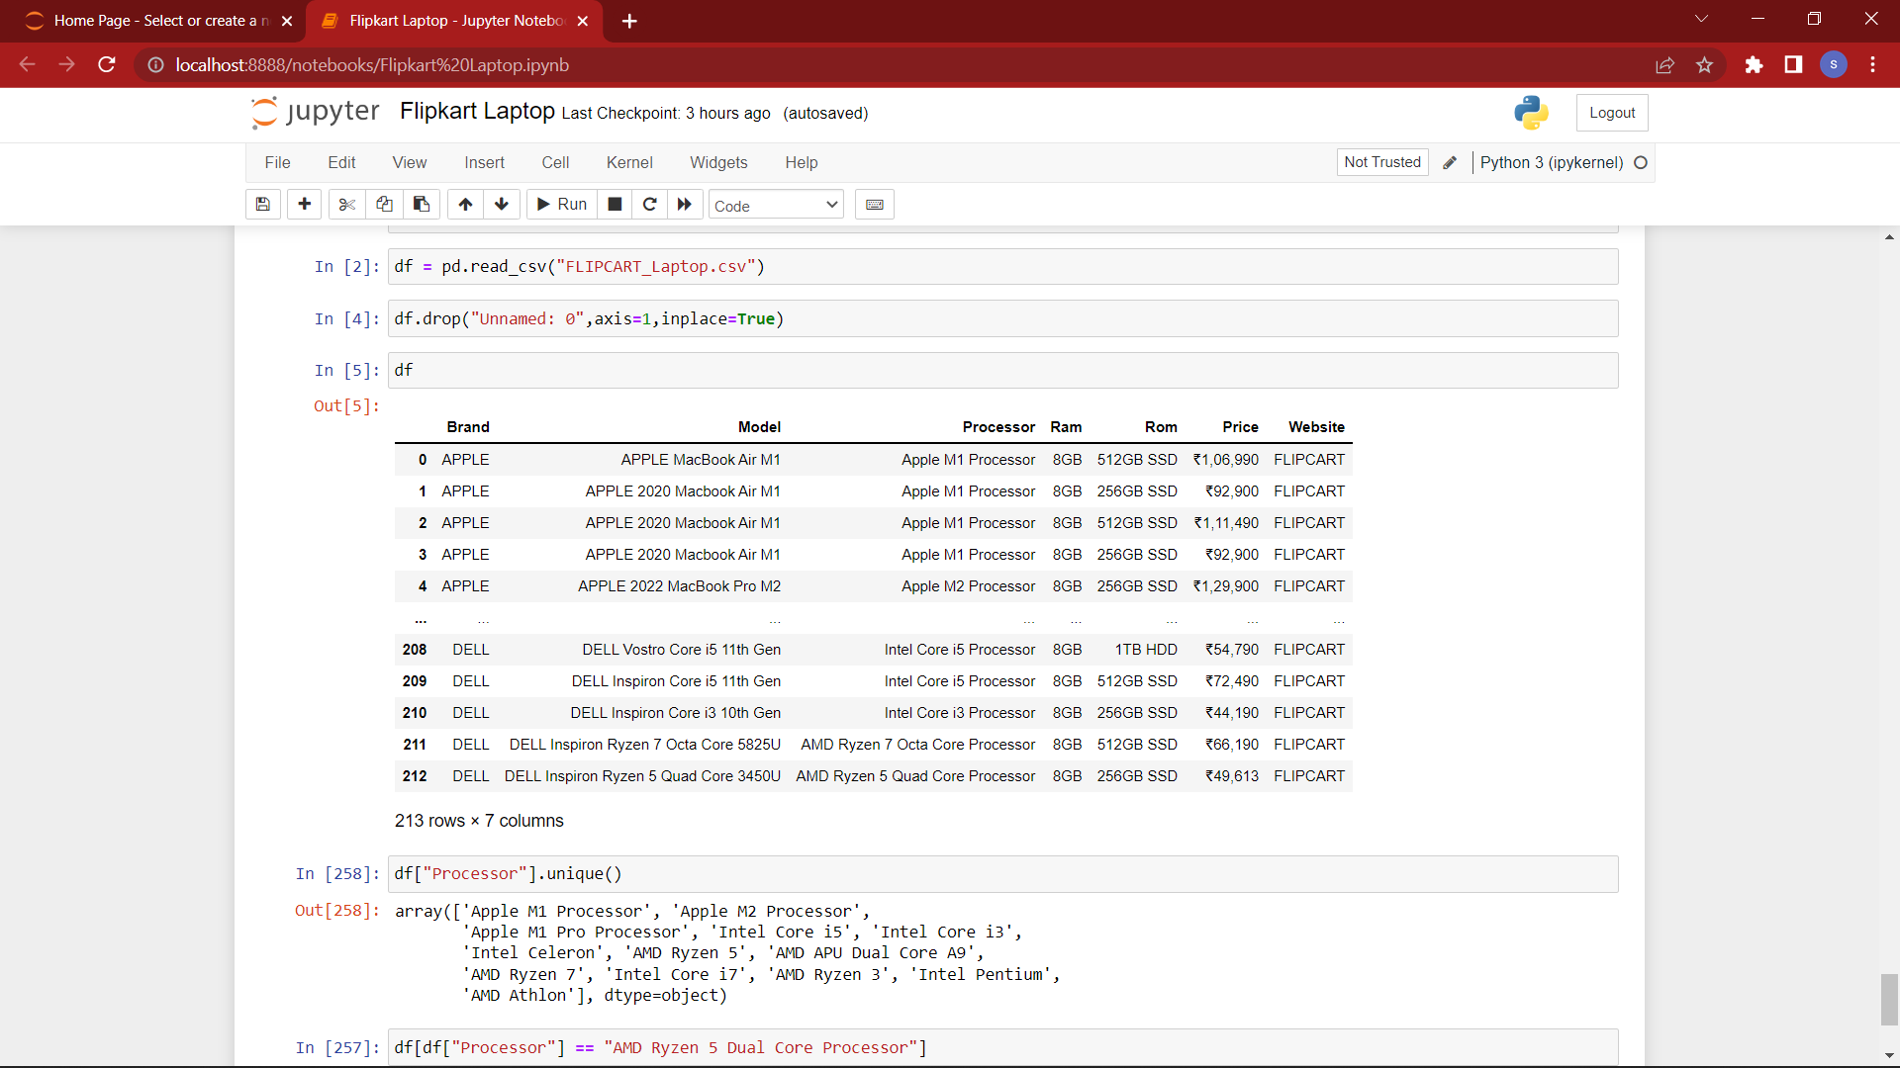
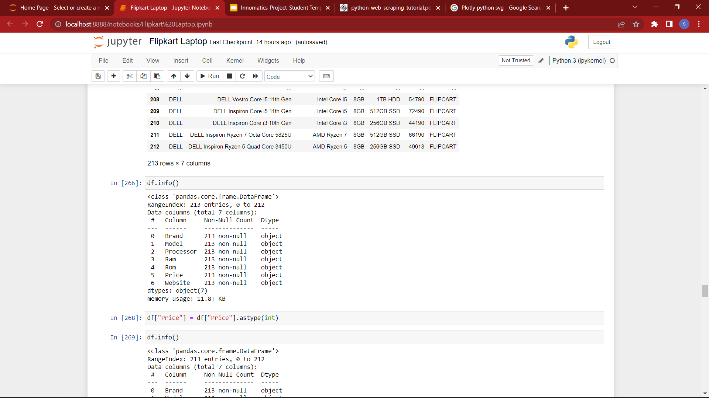
Data Collection :
Scrapped Data / Dataset before Cleaning :
Info of data that is scraped from flipkart.
Notes:
So as you can observe this the dataset that we have scraped from the website and in the right you can observe the information of the dataframe where all the datatypes of the columns are in object form so as you can observe even the price column is also in object data type so in the next slide we will be showing the dataset that has been cleaned .

Slide 9
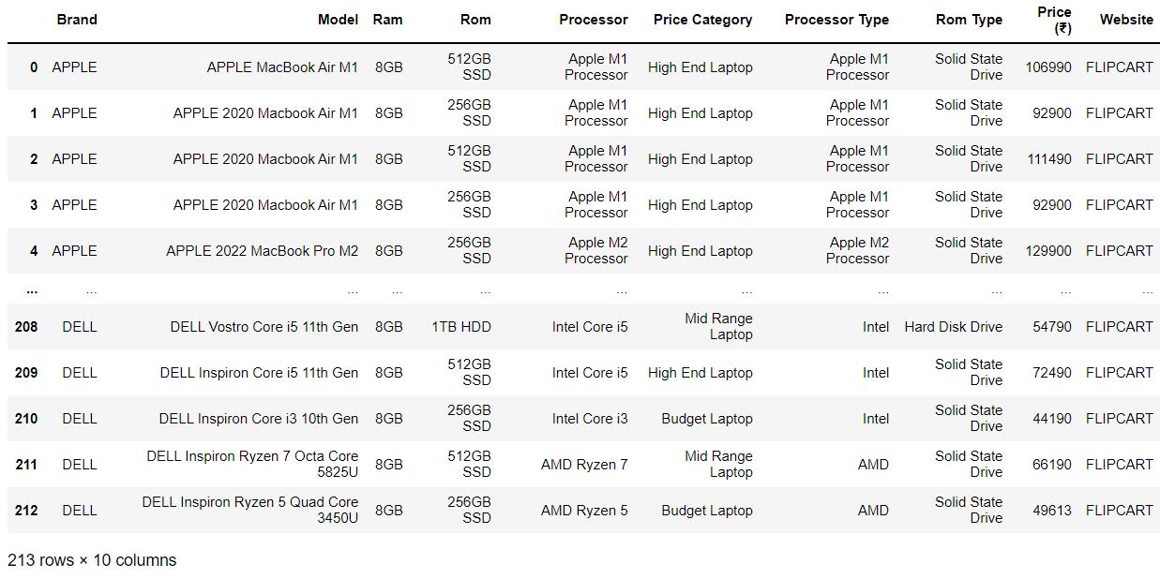
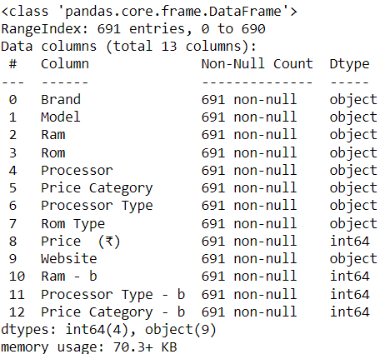
Dataset after Cleaning and Manipulation :
Info after cleaning and manipulating the data
Notes:
So this is the dataset after cleaning and manipulation of the data when u see the information of the data set you can observe that the columns data types are changed to their respective data types and you can observe that there three extra columns that has been made with some columns to make the dataset good for data analysis.

Slide 10
Exploratory Data Analysis
Univariate Analysis
Notes:
So now we will be moving on to the data analysis part so first we will be showing the analysis that we have made for univariate analysis.

Slide 11
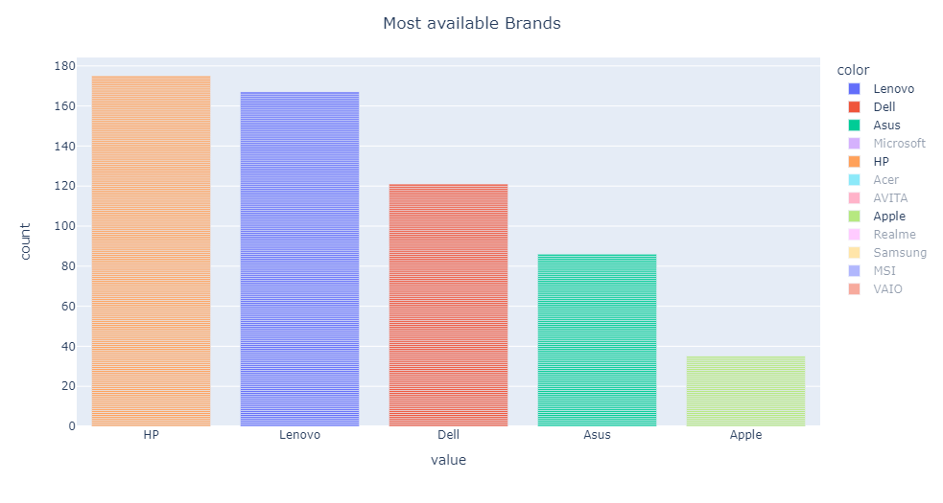
Top 5 Available Brands :
HP - 175
Lenovo - 167
Dell - 121
Asus - 86
Apple - 35
Bar Plot
Notes:
So first we have made the bar plot of laptops that we have in the data set and these are the top 5 brands that are available so hp,lenovo and dell are leading the chart with almost a count of above 100 and asus and apple as you can observe they are less in number.

Slide 12
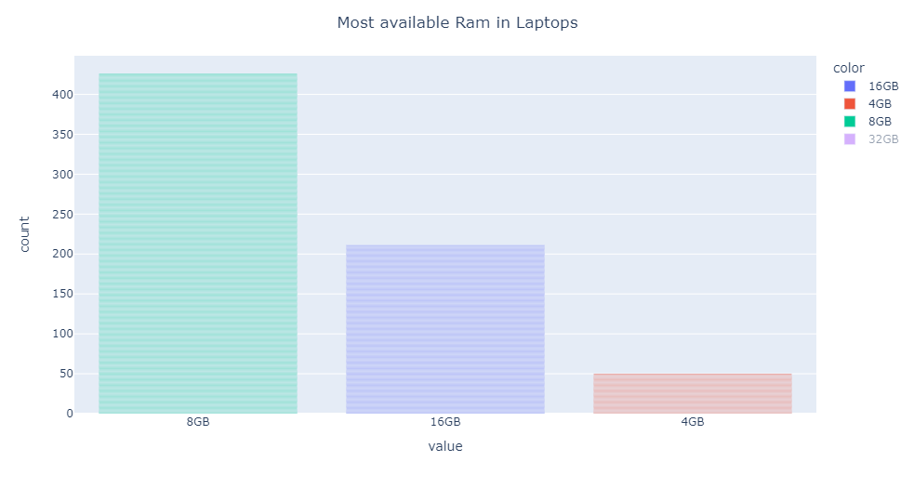
Most Available Ram :
8GB - 426
16GB - 211
4GB - 50
Bar Plot
Notes:
So we made another analysis on the ram which is one of the specification so The speed and performance of your system directly correlate to the amount of RAM you have installed. If your system has too little RAM, it can be slow and sluggish and if ram is higher it is fast in performing certain operations. laptops so by this bar plot we can say that 8GB is the ram that most of the laptops consists of and 16GB is the next highest ram that is available.

Slide 13
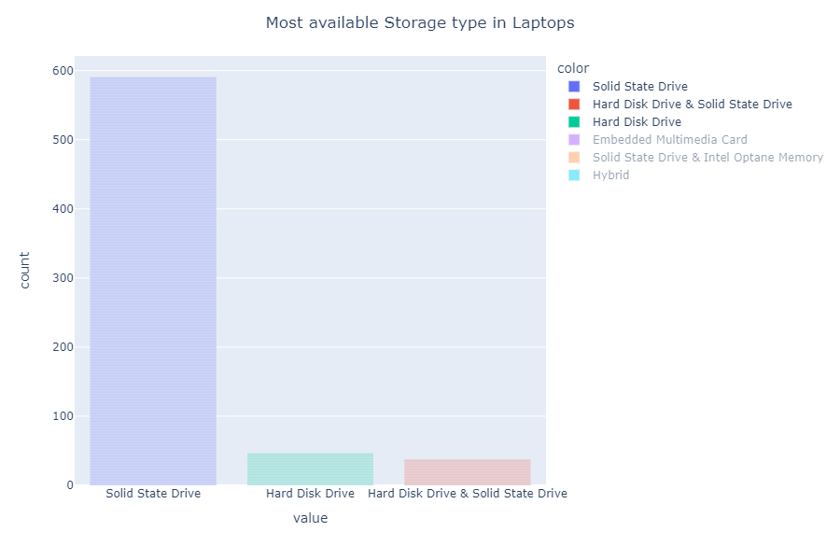
Most Available Rom type :
SSD - 590
HDD - 46
HDD & SSD - 37
Bar Plot

Slide 14
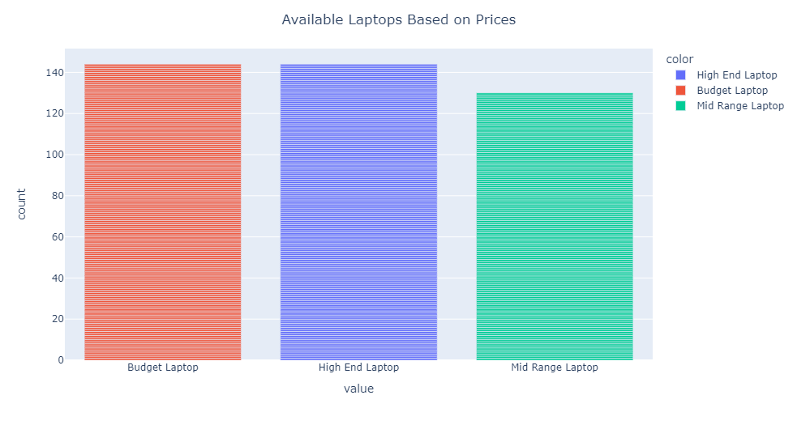
Most Laptop type based on price :
High End Laptop - 144
Budget Laptop - 144
Mid Range Laptop - 130
Bar Plot
Notes:
So here the univariate analysis is made on the price category column this column is made by taking specific range in the price column where we have segregated these three categories i.e Budget , high end and mid range laptops based on the price range.So as you can observe that high end and the budget laptops are equally available in the website whereas the midrange is a bit lesser when compared to other two.

Slide 15
Bivariate Analysis
Notes:
Data science visualization is the representation of data graphically in any format.It is the most efficient way of communicating facts with non technical professionals and helps them draw inferences from the data.

Slide 16
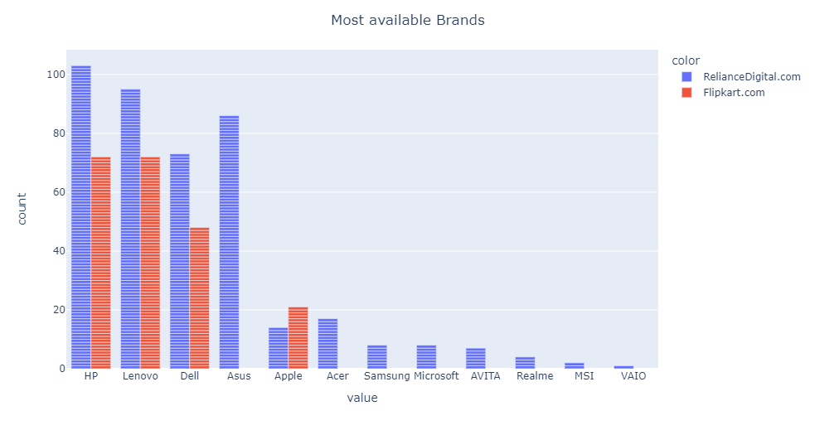
Brand Count on different websites :
HP RelianceDigital.com - 103
Flipkart.com - 72
Lenovo RelianceDigital.com - 95
Flipkart.com - 72
Dell RelianceDigital.com - 73
Flipkart.com - 48
Bar Plot
Notes:
Brandwise count of each website
As you can observe this is the bar plot of all brands that are available in different websites

Slide 17
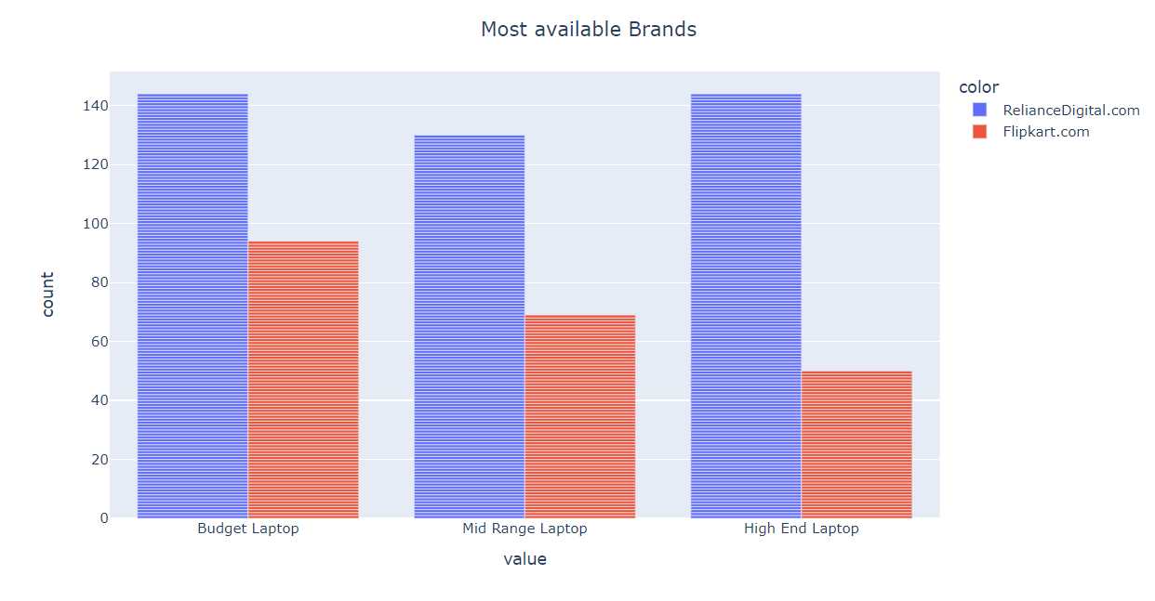
Price category on different websites
Bar Plot
Notes:
Equal number of the high end and budget laptops available in reliance digital website and are high in number when compared with mid range

Slide 18
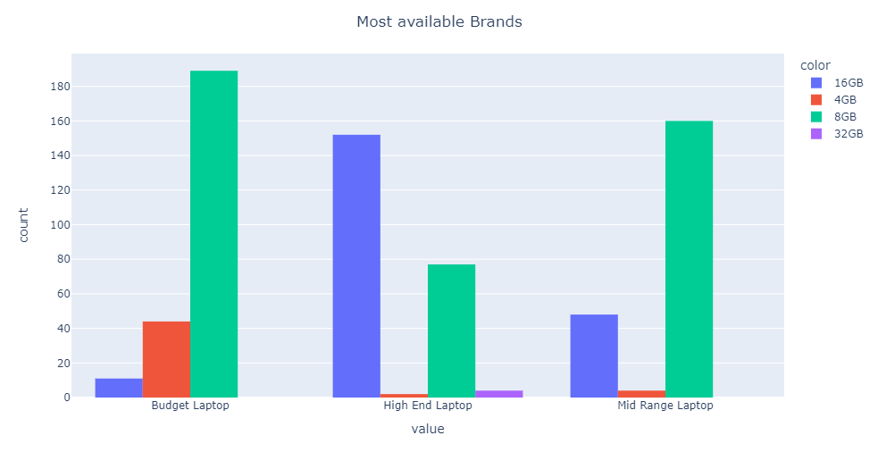
Count based on Ram
Histogram
Notes:
16 GB Ram type is mostly available in high end laptops

Slide 19
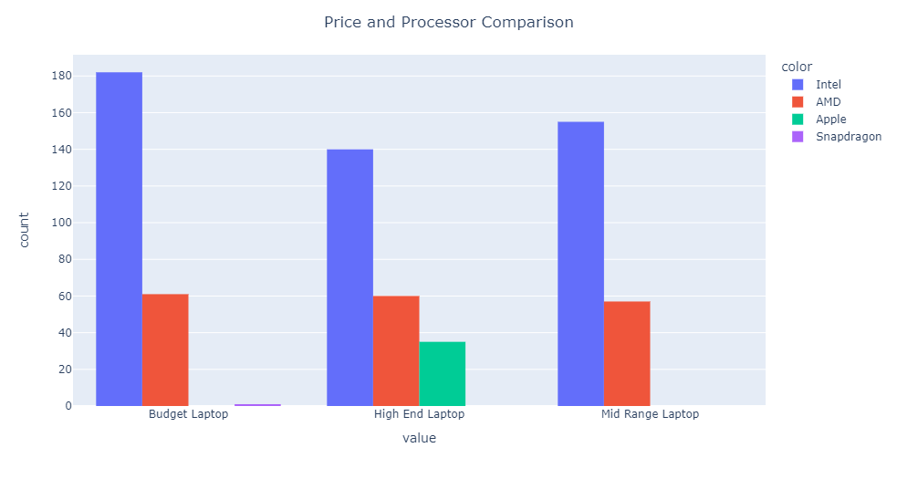
Count based on Processor
Histogram
Notes:
16 GB Ram type is mostly available in high end laptops

Slide 20
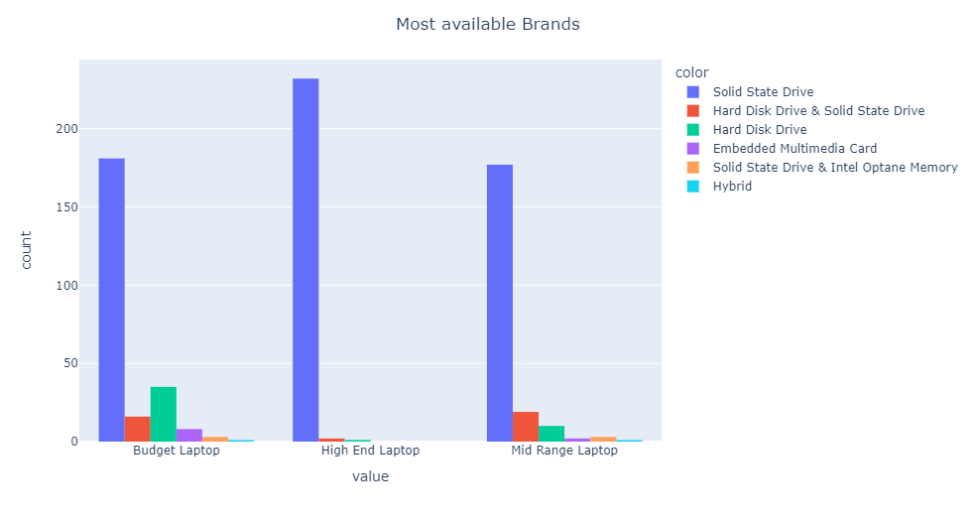
Count Based on ROM
Histogram
Notes:
SSD is highly available Rom type in all the three categories

Slide 21
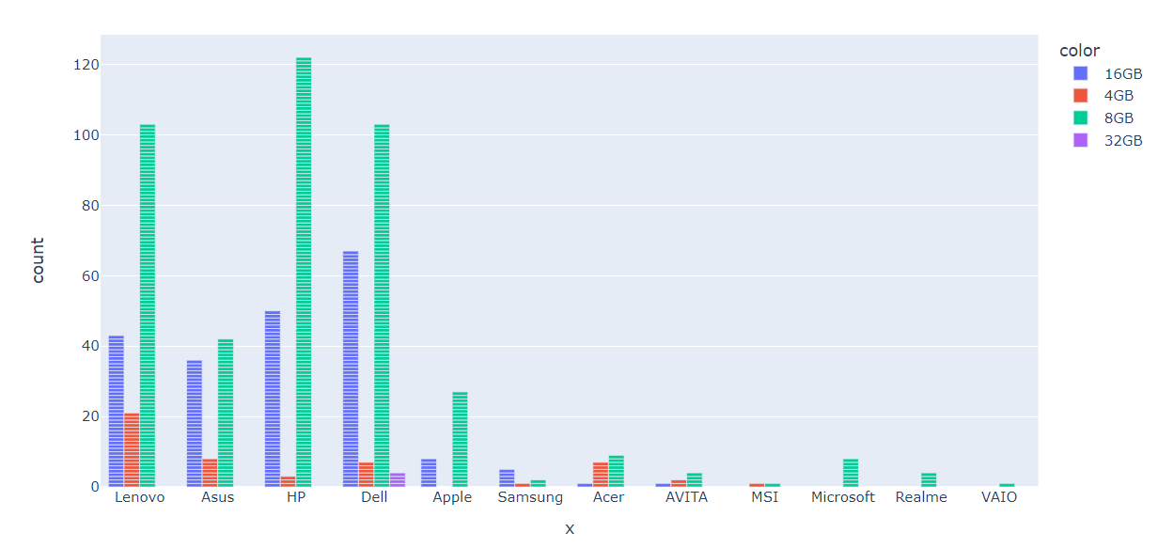
Count Based on Ram
Bar Plot
Notes:
Availability of Ram types in different Brands

Slide 22
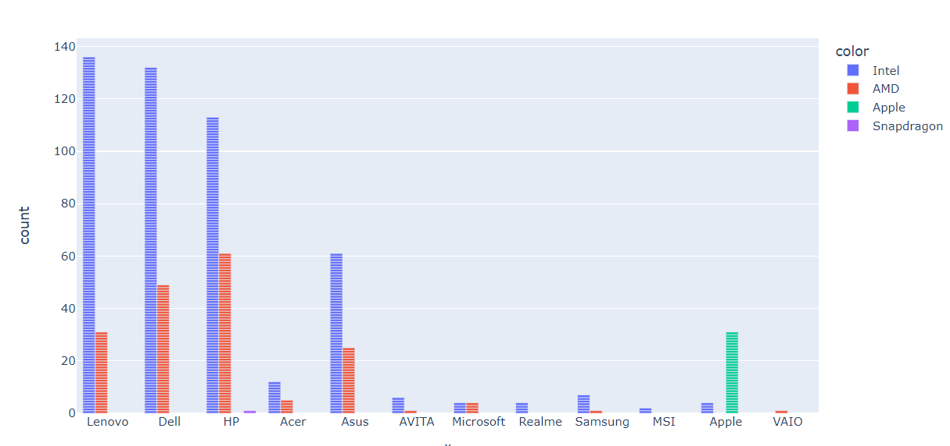
Count Based on Processor
Bar Plot
Notes:
Intel Processors are high count in Maximum Brands

Slide 23
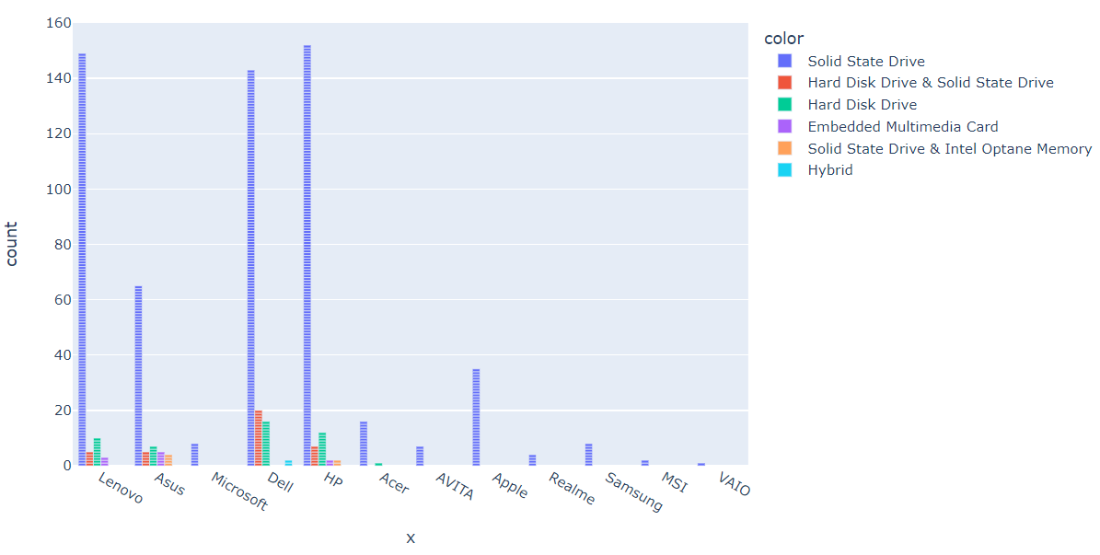
Count based on Rom type
Bar Plot
Notes:
SSD,HDD and it’s combination are commonly used Rom types

Slide 24
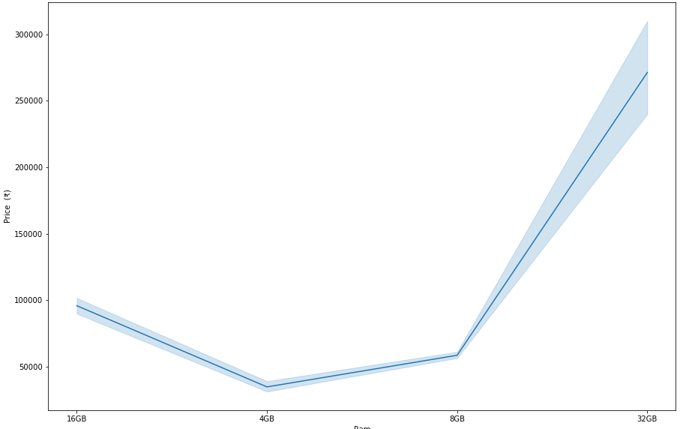
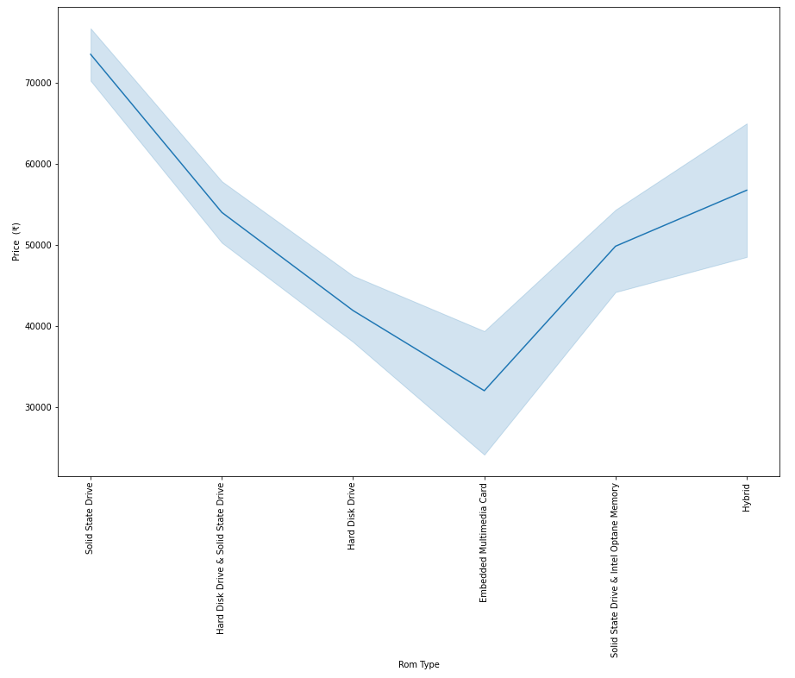
Ram
Rom
Notes:
As you can see laptops with SSD is having higher average price when compared to other storage types and embedded multimedia card is having lesser average price and in the second plot as you can observe for 32Gb laptops are having higher average price following with 16GB and then 8GB Laptops whereas the 4GB is having lesser average price.

Slide 25
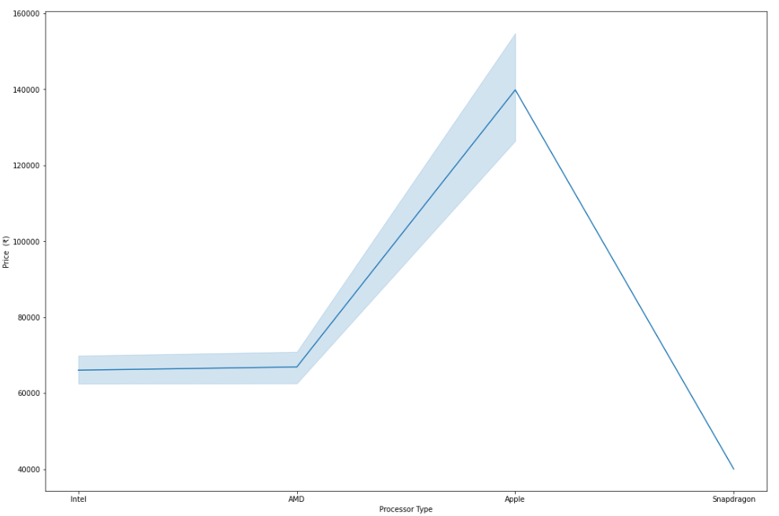
Processor
Notes:
As AMD and INTEL are having nearer average prices so as you can observe the apple chips are having higher average price for a laptop when compared to the other chips.

Slide 26
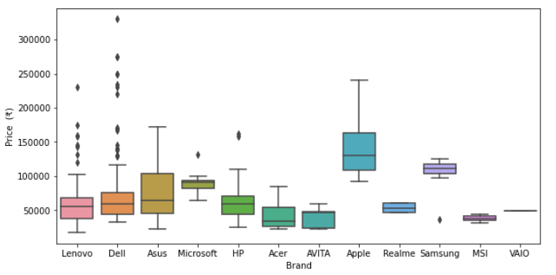
Box plot of Brand with Price
Box Plot
Notes:
High extreme values exist in Dell as compared with Lenovo.Apple laptops are having high range in Price.From box plot we can say LENOVO,HP,ACER,AVITA are maximum available brands in the 35 thousand to seventy thousand budget range.

Slide 27
Multivariate Analysis

Slide 28
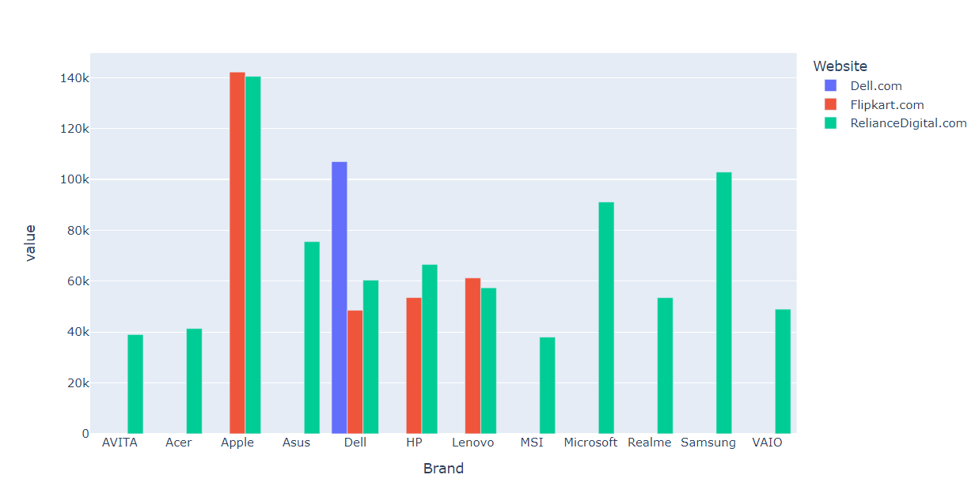
Price of laptops in different websites
Bar Plot
Notes:
Apple laptops are having high price value when compared with Reliance.
MSI laptops are with low cost.
Here we have told based on average price.

Slide 29
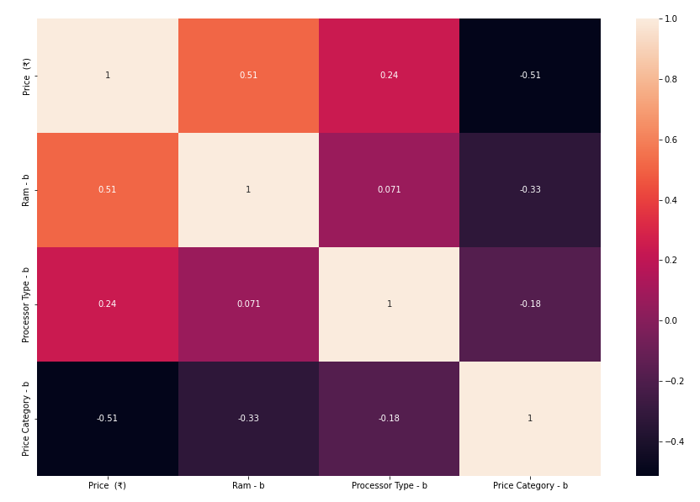
Correlation of Numeric columns
HeatMap
Notes:
Ram is highly correlated with price compare with processor that is as ram storage increases price also increases.
Effect of Ram on price is high compared with processor types like core i3,i5,i7,i9 on price value.

Slide 30
Conclusion :
The price of a laptop is dependent on the Type of Ram, Processor Type and Storage type.
Top 3 Brands that are available are HP , Lenovo and Dell .
Most available Ram is 8GB in most of the laptops .
Most used storage type is SSD .
There are equal number of Budget and High end laptops
HP is the most available laptop in Flipkart and Reliance digital website .
Budget Laptops are having 8GB the most and having SSD as storage type .
Notes:
From our observation most available Brands within Budget that is 35 thousand to 70 thousand are LENOVO,HP,ACER,AVITA(as earlier we have analized from BOX PLOT).Based on rating we will choose model and Brand of product and coming to the price we can compare the product price in own own website like dell,hp,lenovo along with available e commerce platforms that are amazon,flipkart,reliance,bajaj,snapdeal.Then we may have chance to get the product with low price in own websites compare with e commerce platforms.

Slide 31
Challenges faced :
Getting data from three websites .
More number of unique values in a column even they are same .
Selecting a suitable plot to visualize the data.

Slide 32

THANK YOU

